Slide 1
Activity 6: MORPHOLOGICAL OPERATIONS
Genesis Vertudez – 202003099
App Physics 157 - Computational Analysis and Modeling in Physics
Submitted to Dr. Maricor Soriano; Mx. Rene Principe Jr.

Slide 2
OBJECTIVES
Perform morphological operations manually on images given a structuring element
Verify the results numerically
Improve segmented images using morphological operations

Slide 3
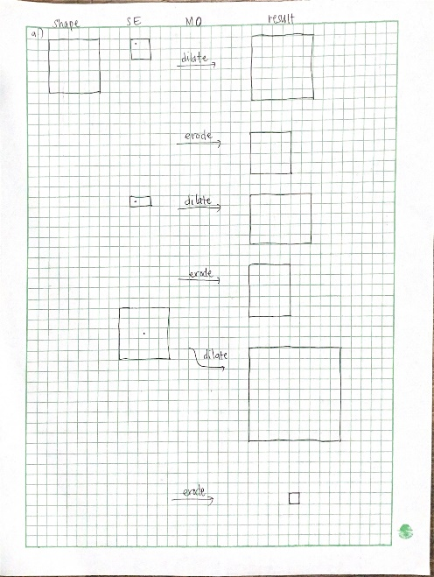
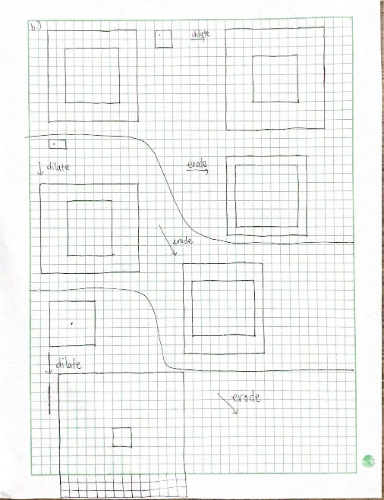
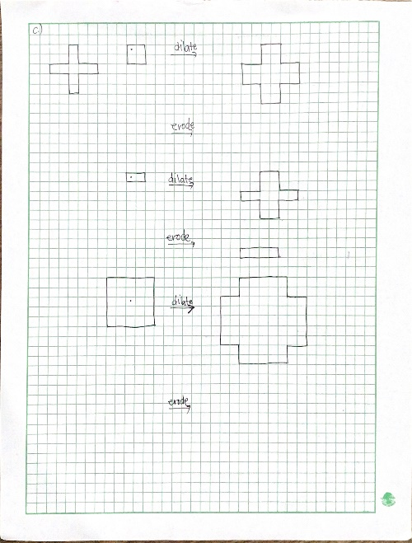
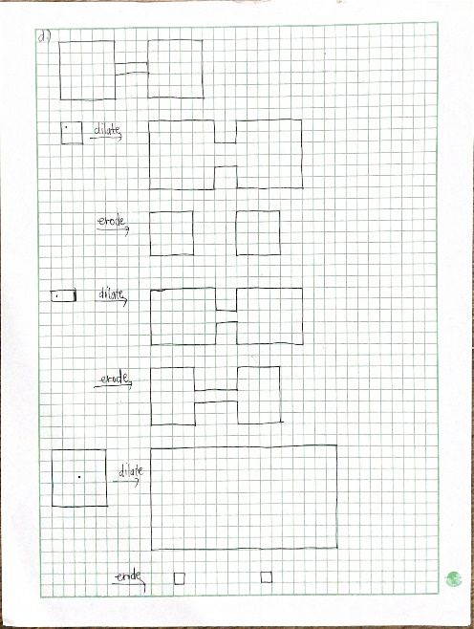
MORPHOLOGICAL OPERATIONS - MANUAL
Morphological operations are usually used on binary images of 0’s and 1’s where the 1’s constitute the image. As the name suggests, they are operations used to manipulate the morphology, or shape, of an image based on a given structuring element (SE). The common morphological operations include the dilation, erosion, opening (erode then dilate), and closing (dilate then erode) operation.
Before trying out the morphological operations available in Python, I tried mapping the results in a graphing paper. Dilation “extends” an image, while erosion “contracts” it. Dilation works by overlapping the origin of the SE over different pixels, and “turning on”, or switching that pixel to a 1 IF the image and the structuring element overlap even by one pixel. On the other hand, erosion works by again overlapping the origin of the SE over different pixels, and turning it on only when the SE is fully inside the image.
Solid square
Hollow square
Plus symbol
Dumbell
Codes and files: https://github.com/genvert/AP_157_FX-2_Vertudez/tree/main/Activity%206

Slide 4
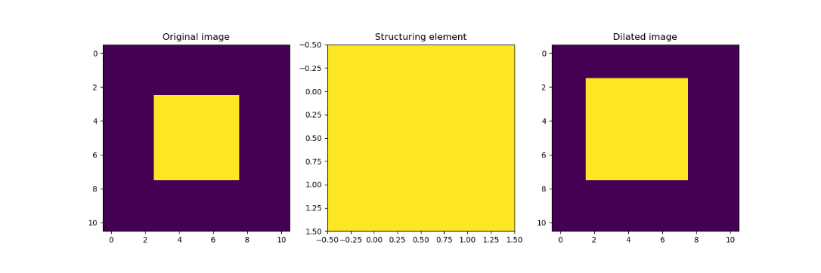
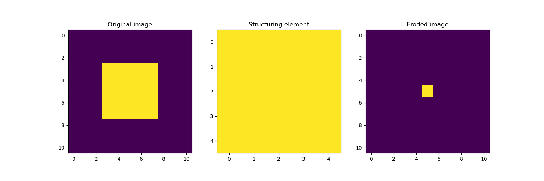
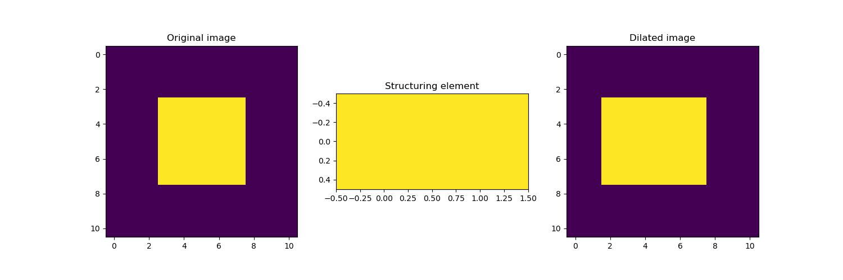
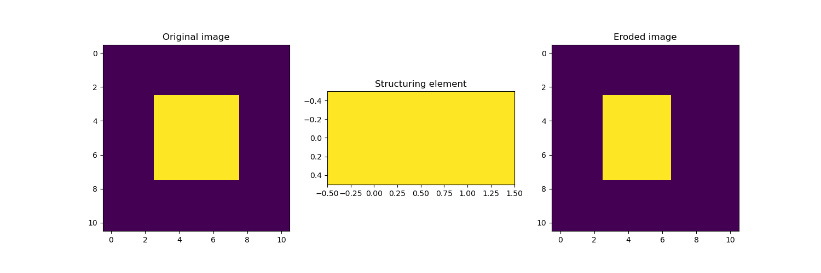
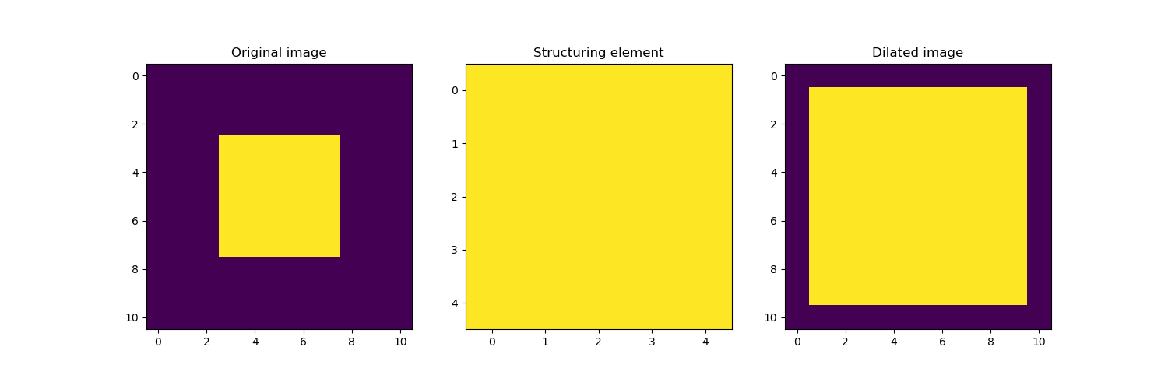
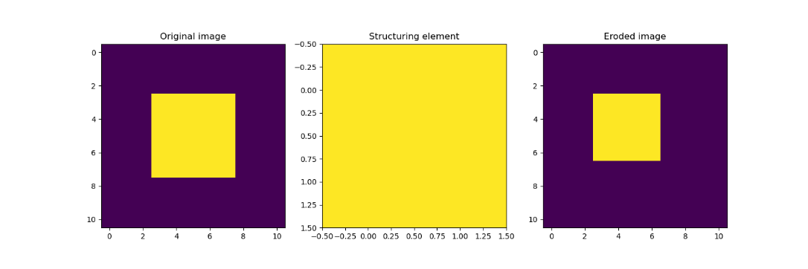
MORPHOLOGICAL OPERATIONS - NUMERICAL
Now, it’s time to try them numerically with Python. The images, as before, are a 5x5 solid square, 10x10 hollow square that is 2 units thick, a plus symbol, and a dumbbell. The structuring elements are still a 2x2 solid square, a 2x1 solid rectangle, and a 5x5 solid square.
Image: Solid square
Dilation
Erosion
Codes and files: https://github.com/genvert/AP_157_FX-2_Vertudez/tree/main/Activity%206

Slide 5
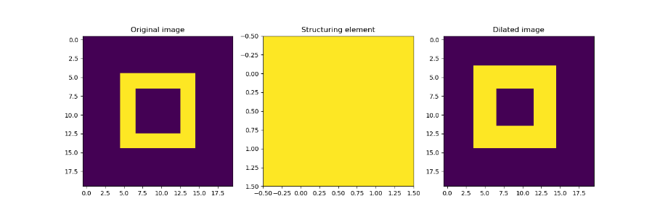
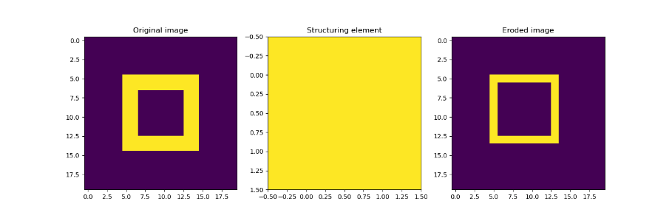
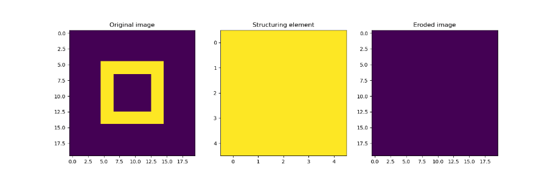
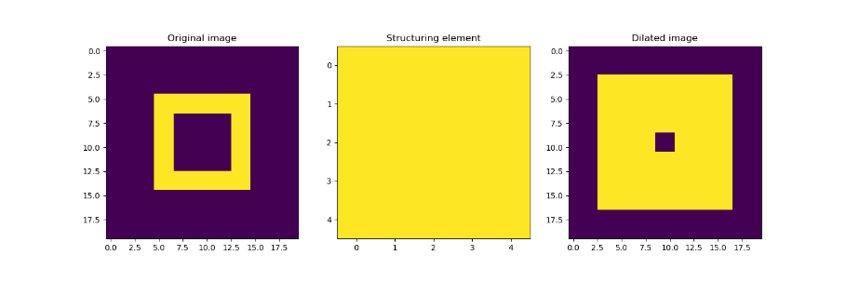
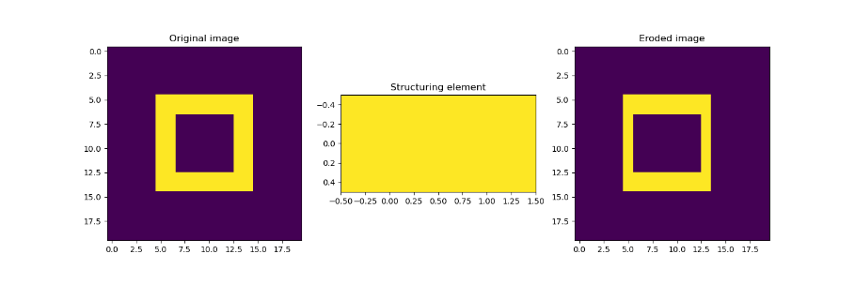
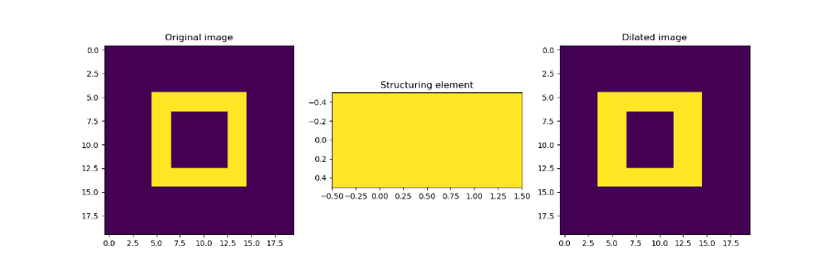
MORPHOLOGICAL OPERATIONS - NUMERICAL
Image: Hollow square
Dilation
Erosion
Codes and files: https://github.com/genvert/AP_157_FX-2_Vertudez/tree/main/Activity%206

Slide 6
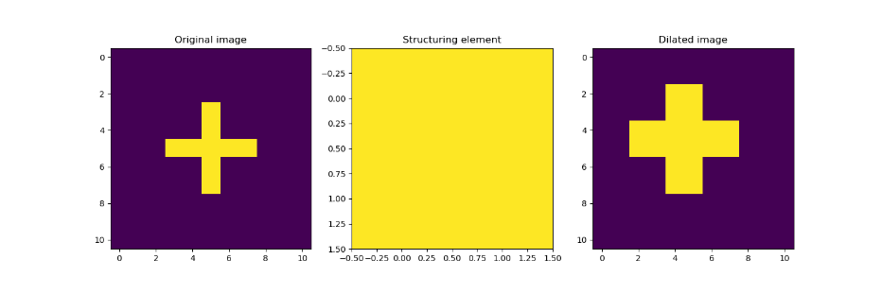
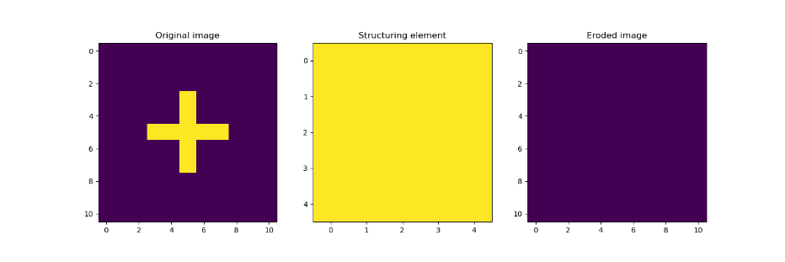
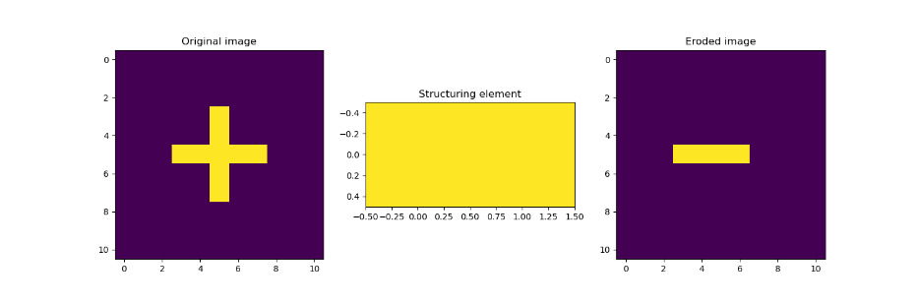
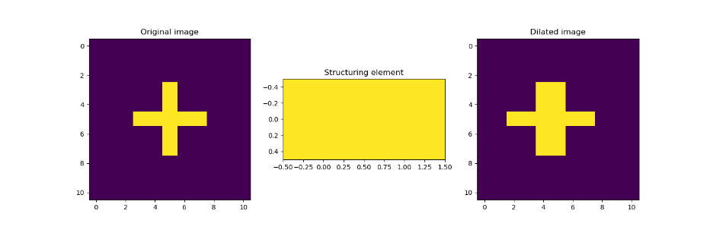
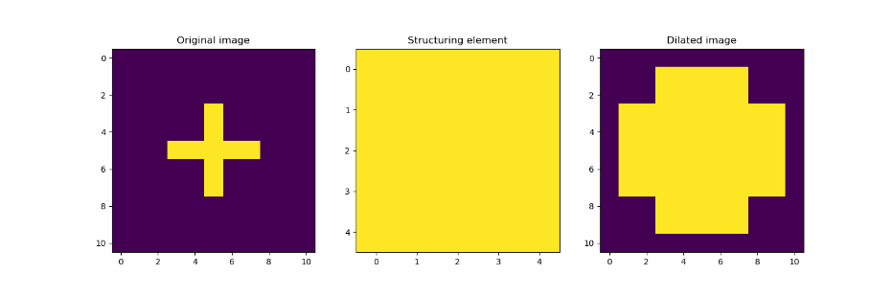
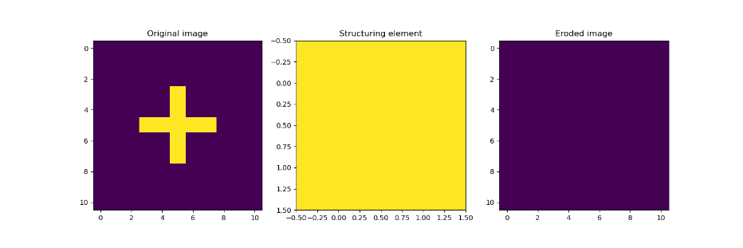
MORPHOLOGICAL OPERATIONS - NUMERICAL
Image: Plus symbol
Dilation
Erosion
Codes and files: https://github.com/genvert/AP_157_FX-2_Vertudez/tree/main/Activity%206

Slide 7
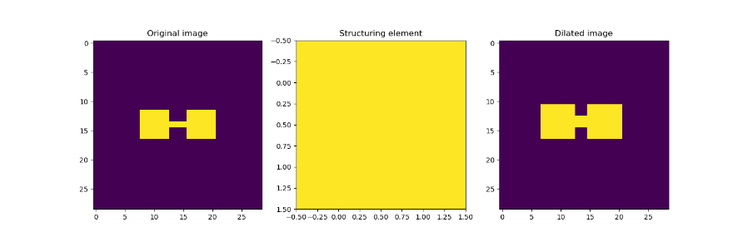
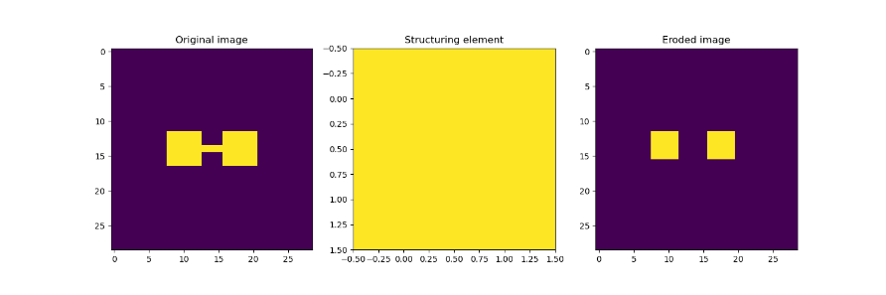
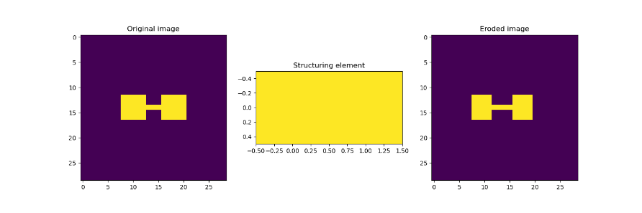
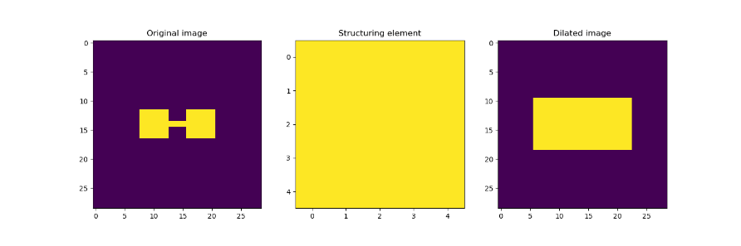
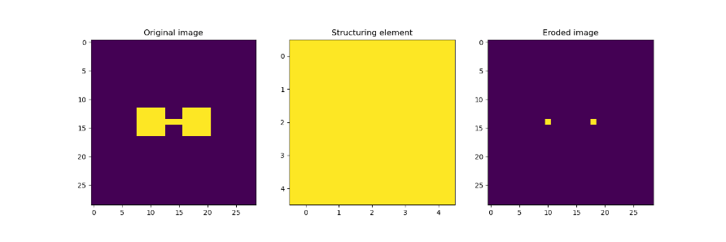
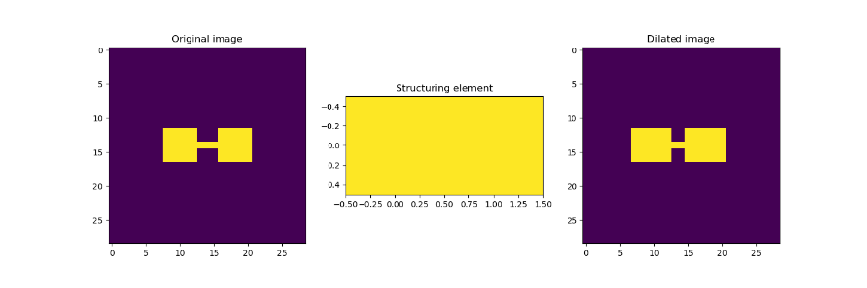
MORPHOLOGICAL OPERATIONS - NUMERICAL
Image: Dumbbell
Dilation
Erosion
Codes and files: https://github.com/genvert/AP_157_FX-2_Vertudez/tree/main/Activity%206

Slide 8
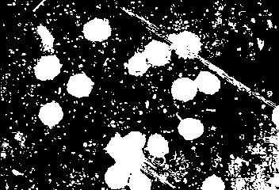
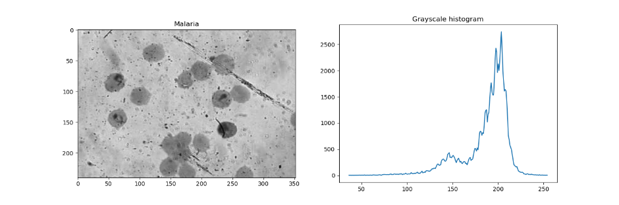
MORPHOLOGICAL OPERATIONS - NUMERICAL
Codes and files: https://github.com/genvert/AP_157_FX-2_Vertudez/tree/main/Activity%206

Slide 9
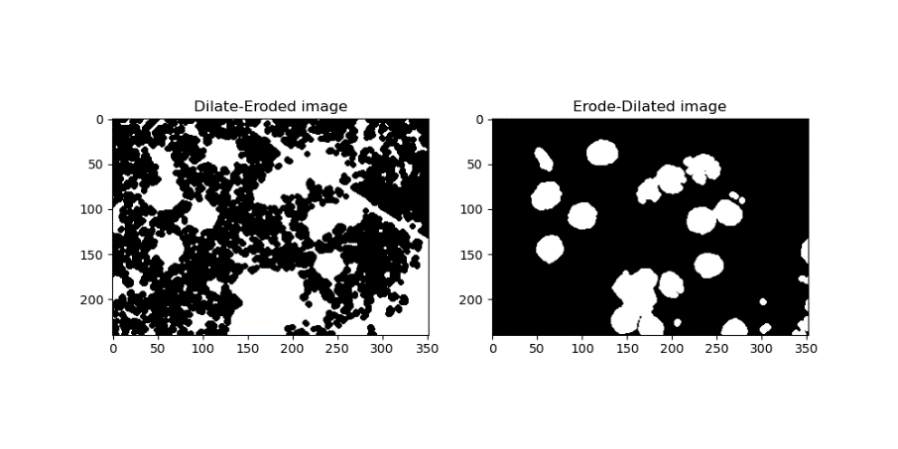
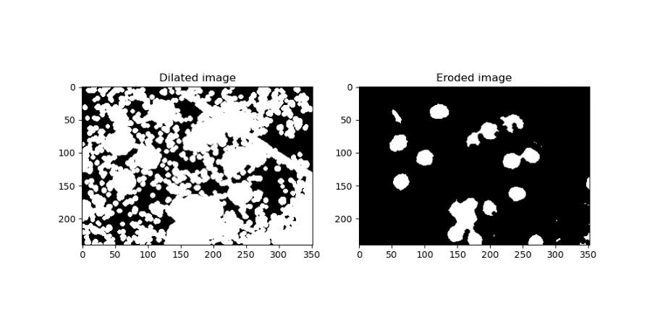

MORPHOLOGICAL OPERATIONS - NUMERICAL
Codes and files: https://github.com/genvert/AP_157_FX-2_Vertudez/tree/main/Activity%206

Slide 10
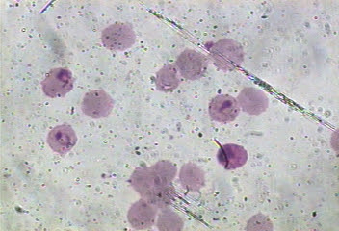
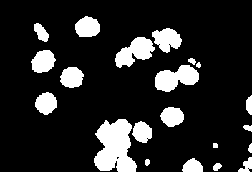
MORPHOLOGICAL OPERATIONS - NUMERICAL
Codes and files: https://github.com/genvert/AP_157_FX-2_Vertudez/tree/main/Activity%206

Slide 11
REFLECTION
This activity was very fun. It was repetitive (in a nice way) which made me get very familiar with the application of Fourier analysis in image processing.
The previous activity was definitely helpful in letting me understand the ideas behind the removal of periodic patterns.
I just want to say that the product of rotated sinusoids produce beautiful Fourier transforms!

Slide 12
SELF-GRADE
Technical correctness: 35/35
I am confident that I understood how the Fourier transform of images work and how to manipulate their properties for image processing.
Quality of presentation: 35/35
I have explained each step and idea, and images are clear and concise.
Self-reflection: 30/30
The activity was repetitive in using Fourier transform so it helped me strengthen my knowledge on it.
Initiative: 10/10
I went beyond the expected output.

Slide 13
REFERENCES
[1] Soriano, M. (2023). AP 157 module. Activity 2 Part 2 - Properties and Applications of the 2D Fourier Transform 2021 – Copy.
[2] Fingerprint photo. https://www.researchgate.net/figure/Examples-of-different-classes-of-fingerprints-a-right-loop-b-whorl-and-c-arch_fig2_265986190
[3] Lunar landing photo. https://www.lpi.usra.edu/publications/slidesets/apollolanding/ApolloLanding/slide_05.html

